Slide 1

Predicting Teams Best Suited for Participation in the College Football Playoff
Richard E. Molina
Department of Computer Science and Engineering
Data Mining Course Project
December 11, 2014

Slide 2
Introduction
Over the past 2 decades, college football has been plagued by controversy over how it determines its national champion.
3 Eras of College Football
Prior to 1998: No System
1998-2014: Bowl Championship Series (BCS)
2014- : College Football Playoff

Slide 3
Prior to 1998
No system in place
Champion(s) determined by two polls
Associated Press (AP) Poll
Coaches Poll
Top teams would often not face each other on the field
Split Championships
Each Poll named a different champion
Who would win between the two?

Slide 4

Bowl Championship Series (BCS)
3 part system w/ equal weights
Associated Press (AP) Poll
Coaches Poll
Computer rankings
Match up top 2 teams in championship game.
Winner would be champion
Essentially a 2-team playoff
What happens when more than 2 teams are deserving of a championship opportunity?
2004 (USC, Oklahoma, Auburn)
2010 (Auburn, Oregon, TCU)

Slide 5
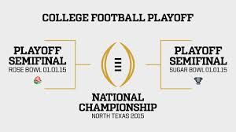
College Football Playoff
Selection Committee
13 Members
Collaborate and ranks teams based on season performance on the field
Top 4 teams will advance to a seeded playoff

Slide 6
Problem Statement
Even with the new system, the same fundamental problems and issues exist.
How do we determine the teams that are most deserving of a playoff spot?
This work aims to identify the key attributes of the best teams of season’s prior and attempt to solve the age-old question of college football:
Who really is the best team in the country?

Slide 7
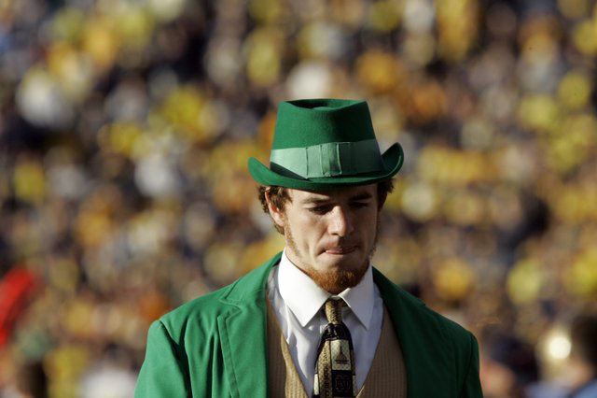

Spoiler Alert!
It’s not Notre Dame ☹

Slide 8
Knowledge Discovery Process
Data Acquisition
ESPN.com – Overall Season data
Warren Repole/Sunshine Forecast – Individual Game Data
Data Validation
ESPN Stats & Information Department
Data Understanding/Feature Selection
Identify stats and attributes that are more representative of the top teams in the country
Model Development
Build ranking algorithm using these identified statistics and attributes

Slide 9
Key Features Identified
Winning Percentage
Points Scored/Allowed
Strength of Schedule
Strength of Conference
Margin of Victory
Strength of Victory
Strength of Defeat
Conference Championship

Slide 10
Algorithm Components
Ranking Algorithm is divided into four distinct factors
Points Ratio
Strength of Margin of Victory
Strength of Record
Conference Factor
Final score for the team ranking is calculated by summing the four factors together

Slide 11
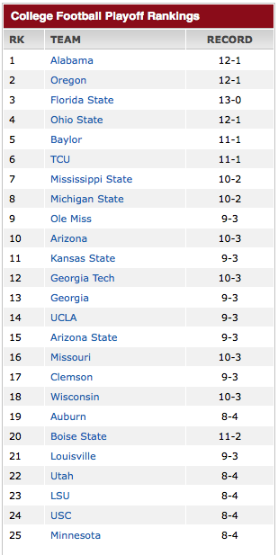
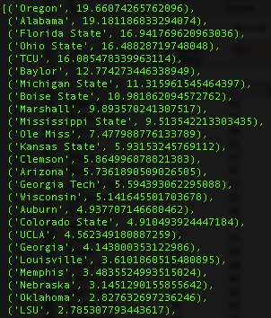
Results

Slide 12
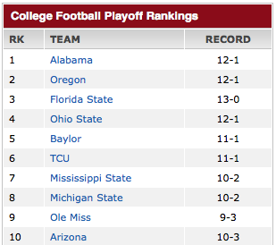
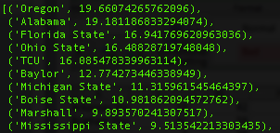
Results

Slide 13
Conclusion
Successfully identify key features and attributes that are most indicative of the top teams
My rankings for the current year are almost in agreement with the 13 person committee
Agree on the top 6
Agree on 8 of the top 10
My Rankings reward outright conference championships
Marshall and Boise State in the top 10
Current Committee undervalues teams outside of “Power Five” Conferences

